Slide 1
Aristotle: Foundations
Reading Aristotle, political enquiry and method, virtue and human happiness
Classical and Renaissance Political Thought
Politics 2A 2019
K. Wright

Slide 2
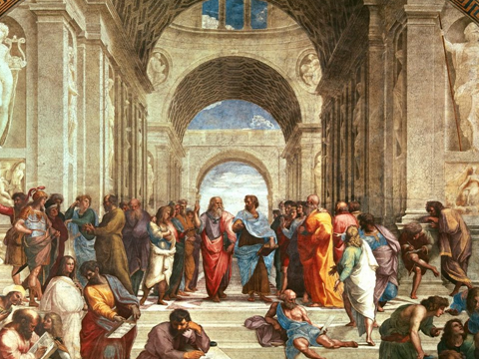

Slide 3
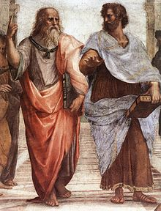
Plato and Aristotle
Plato: ideal forms and pure principles
Aristotle: experience of and in the world

Slide 4
Aristotle lectures
Foundations: Reading Aristotle, the nature of politics and political enquiry, Aristotle’s method, happiness, virtue and the good life.
Aristotle’s Politics 1: Household, property, women, children and slaves. Role of education.
Aristotle’s Politics 2: Constitutions, citizenship, equality and justice
*******
Aristotelian Legacies

Slide 5
Today
Background
Reading Aristotle
The nature of political science and political enquiry
Aristotle’s method
Human nature
Human happiness (eudaimonia), virtue, and the good life
(largely from The Nichomachean Ethics)

Slide 6
Aristotle
Born 384 BC in Macedonia
Plato’s Academy (367-347BC)
Exile of 12 years. Tutor to Alexander the Great
Founded Lyceum outside Athens 334BC (13 years)
Fled Athens
Political context:
On-going political turmoil and wars
Decline of the Greek city state
Foreigner in Athens

Slide 7
Reading Aristotle
Common structure of argument: 1. initial proposition 2. examination (extended, not always continuous) 3. revision/conclusion
Reading Aristotle’s ‘esoteric’ works – his ‘lecture notes’ Books, chapters and Bekker #s (BkII, vii: 1279a32)
Most of Aristotle’ broader ‘exoteric’ work is thought lost.
Aristotle’s work and influence lost and rediscovered more than once. Early Byzantine Christian scholars translated and preserved his works. From 600- 1100 Aristotle was unknown in Europe but considered the ‘First teacher’ among Muslim scholars (Averroes and others.) ‘Rediscovery’ in 12th Century Europe heavily influenced Thomas Aquinas and natural law theory.

Slide 8
Politics and political enquiry

Slide 9
Aristotle and Politics
Aristotle ‘founder’ of political and social science. First to articulate its purpose, nature and methods.
‘Politics’ = study of society, broadly social science.
Philosopher and comparative political scientist. The Politics rests on analysis of the records of over 150 constitutions.

Slide 10
Nature of Political Science (Bk 1-2 NE)
Politics is a practical (applied) science, concerned not with (true) knowledge but with right actions (phronesis.) It is general, neither exact nor deductive.
Phronesis (practical wisdom) requires good judgement from experience (‘know-how’.) Its aim is to guide political judgements .
Politics (like Ethics) requires reflection on experience, and therefore can’t be learned from books or lectures. Thus it can’t be taught to the young, those without experience, or those with corrupt ways.

Slide 11
Aristotle’s Approach
Empirical – Knowledge rests on evidence:
- Facts
- Opinions (discourse), both ‘common’ and ‘authoritative’
Teleological – The telos, or ultimate end or aim of any activity defines its nature.
- Ex: the telos of man is happiness / flourishing

Slide 12
Method
The precision of any enquiry is determined by the nature of the subject. Because politics is a general subject , its ‘truths’ must be general ones, broad outlines, and those who engage in it should have general knowledge from general experience.
The study of politics is empirical and discursive. Aporetical Method (resolving puzzles). Begin with the ‘phainomena’ – the appearances – facts and opinions.
If something is true, (all) data will be in harmony with it

Slide 13
Human nature
The good man needs judgement from ‘experience’ (phronesis) derived from ‘virtuous living under good laws’
Contemplation is the highest form of activity: it is ‘self-sufficient’. BUT however much men strive for the divine, ultimately they are mortal and must live in communities.
Contemplation can only be a ‘way of life’ for gods. Humans must live well with others. They need friends.
Friendship is best among equal citizens who see and support the best in each other. A polis rests on ‘communal friendship.’

Slide 14
Ethical framework

Slide 15
Human happiness (eudiamonia)
The telos or ultimate aim of human life is eudaimonia, or human happiness. Eudiamona is the result of a lifetime of virtuous action.
Acorn and oak tree
Man is by nature a political animal, a ‘zoon politikon’
A happy (flourishing) man is one who acts in accord with complete virtue, and who is adequately furnished with external goods, throughout a complete lifetime.

Slide 16
Virtuous Action
Moral virtues are developed through practice (habituation) We acquire virtues by first exercising them.
Virtue is not a feeling or a faculty but a purposive disposition (character) lying in a mean that is relative to us, and determined by reason, and by standards which a prudent man would use to determine it.
Virtuous action aims at hitting the mean for that actions. The mean is that which is neither excessive of deficient, and is not the same for all.
Continence and incontinence

Slide 18
What about politics?
Politics is the study of the supreme good of man, and how to achieve it.
The purpose of politics is to foster human excellence and eudaimonia. The object of a constitution and legislation is to create a society that will engender good citizens through habituation and create the conditions for its citizens to be able to achieve eudaimonia.

Slide 19
And now to The Politics……
“So let us first try to review any valid statements…and then consider, in the light of our collected examples of constitutions, what influences conserve and what are destructive of a state, ….and for what reasons some states are well-governed, while in others the contrary is the case. For after examining these questions we shall perhaps see more comprehensively what kind of constitution is the best, and what is the best organisation for each kind, and the best systems of laws and customs for it to use. Let us then begin our account.” NE Bk 10

